Slide 1
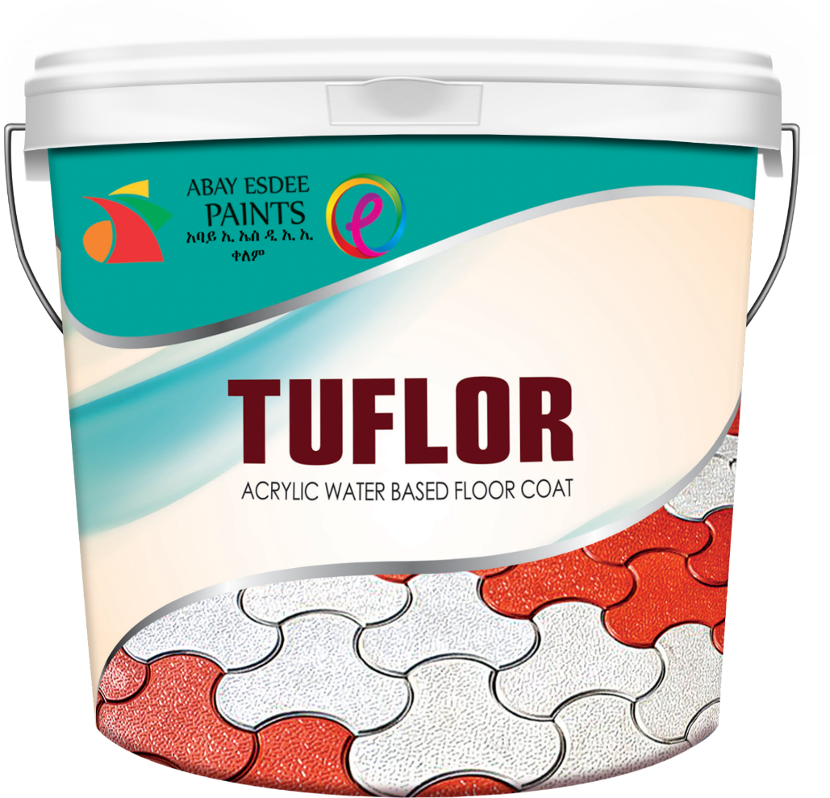


Slide 2
Introduction
MY NAME IS JESAL MEHTA (CEO) OF ABAY ESDEE PAINTS
ABAY ESDEE PAINTS IS A PAINT MANUFACTURING COMPANY SINCE PAST 10 YEARS. WE PRODUCE ALL TYPE OF DECORATIVE, INDUSTRIAL, WOOD, AUTOMOTIVE & CUSTOMIZED SPECIALITY COATINGS.
OUR COMPANY IS JOINT VENTURE WITH ESDEE PAINTS LTD, INDIA WHICH IS 1 OF THE LARGEST PRIVATELY OWNED PAINT MANUFACTURING COMPANY IN INDIA. ITS HAVING 6 MANUFACTURING PLANTS ACROSS INDIA. ITS WELL KNOWN FOR ITS DECORATIVE, INDUSTRIAL, WOOD AND AUTOMOTIVE REFINISH PAINTS.

Slide 3
Business Opportunities
AT PRESENT WE SEE A LOT OF DEMAND FOR WATER BASE EXTERIOR FLOOR COATING/ROAD MARKING PAINT.
Example:
  RESIDENTIAL PROJECT, MANY CUSTOMER STILL USE THE TRADIONAL TERAZZO TILE AND THIS CAN BE CHANGED TO COLORED PAVER BLOCKS WITH THIS PAINT.
  FOR INDUSTIAL FLOOR COATING- WE ARE GETTING LOT OF DEMAND FROM THE HEALTH SECTOR, FOOD & WATER BOTTLING MANUFACTURING PLANTS- DUE TO HYGENIE CONCERNS SET FROM THE MINISTRY OF HEALTH.
  WOOD COATING- AS ETHIOPIA HAS GOOD QUALITY OF WOOD WE HAVE MORE AND MORE CLIENTS IN WOOD & FURNITURE WORKSHOPS- GOOD QUALITY OF FINAL PRODUCT IS IN DEMAND FROM PRIVATE SECTOR LIKE 2K POLYURETHANE PAINTS AND METALIC 2K POLYURETHANE PAINTS.
  SO WE AS A COMPANY THRIVE TO DEVELOP NEW PRODUCTS FOR ALL OUR CUSTOMERS

Slide 4
Advantages of TUFLOR
TUFLOR IS A CROSS LINKED ACRYLIC WATER BASED EMULSION FOR FLOOR COATING WITH HIGH SOLIDS FILM AND BETTER OPACITY WITH A RICH.
TUFLOR CAN BE APPLIED DIRECTLY ON PAVER BLOCKS, CONCRETE/ASPHALT ROADS. IT CAN BE USED AS A ROAD MARKING PAINT WATER BASE. IT CAN BE APPLIED AT AIRPORT PARKING LOTS, OPEN SPORTS GROUND AND UNDER SEATING AREA OF SPECTATORS IN STADIUM.
TUFLOR HAS EXCELLENT PENETRATION & STRENGTH WHICH MAKES IT IDEAL PRODUCT FOR PAINTING OVER INTERLOCKING BLOCKS AND CONCRETE/ASPHALT FLOORS.
TUFLOR HAS LONG DURABILITY, SO LESS FREQUENCY OF REPAINTING.
TUFLOR IS UV RESISTANT FOR EXTERIOR APPLICATION.
TUFLOR HAS MANY COLOR OPTIONS TO DECORATE THE FLOOR
TUFLOR IS A LOW VOC PRODUCT AND ECO FRIENDLY.

Slide 5
TUFLOR IS FAST DRYING COMPARED TO SOLVENT BASE, ALLOWING FOR QUICKER TRAFFIC RELEASE DURING OPERATION.
TUFLOR HAS HIGHER PRODUCTIVITY, LESS TIME FOR APPLICATION EVEN UNDER HIGH HUMIDITY AND CAN BE SPRAYED BY AIR/AIRLESS SPRAY MACHINE.
TUFLOR HAS ENHANCED GLASS BEADS RETENTION RESULTING HIGHER LONG TERM RETROREFECTIVITY.
TUFLOR DOES NOT SOFTEN ON ENVIORNMENTAL HEAT, HENCE LOW DIRT PICK UP.
TUFLOR IS SAFER TO HANDLE, HEATING IS NOT REQUIRED AND EASIER TO HANDLE WASTE.
TUFLOR WATERBORN APPLICATION PROVIDES AN OVERALL COST BENEFIT.

Slide 6
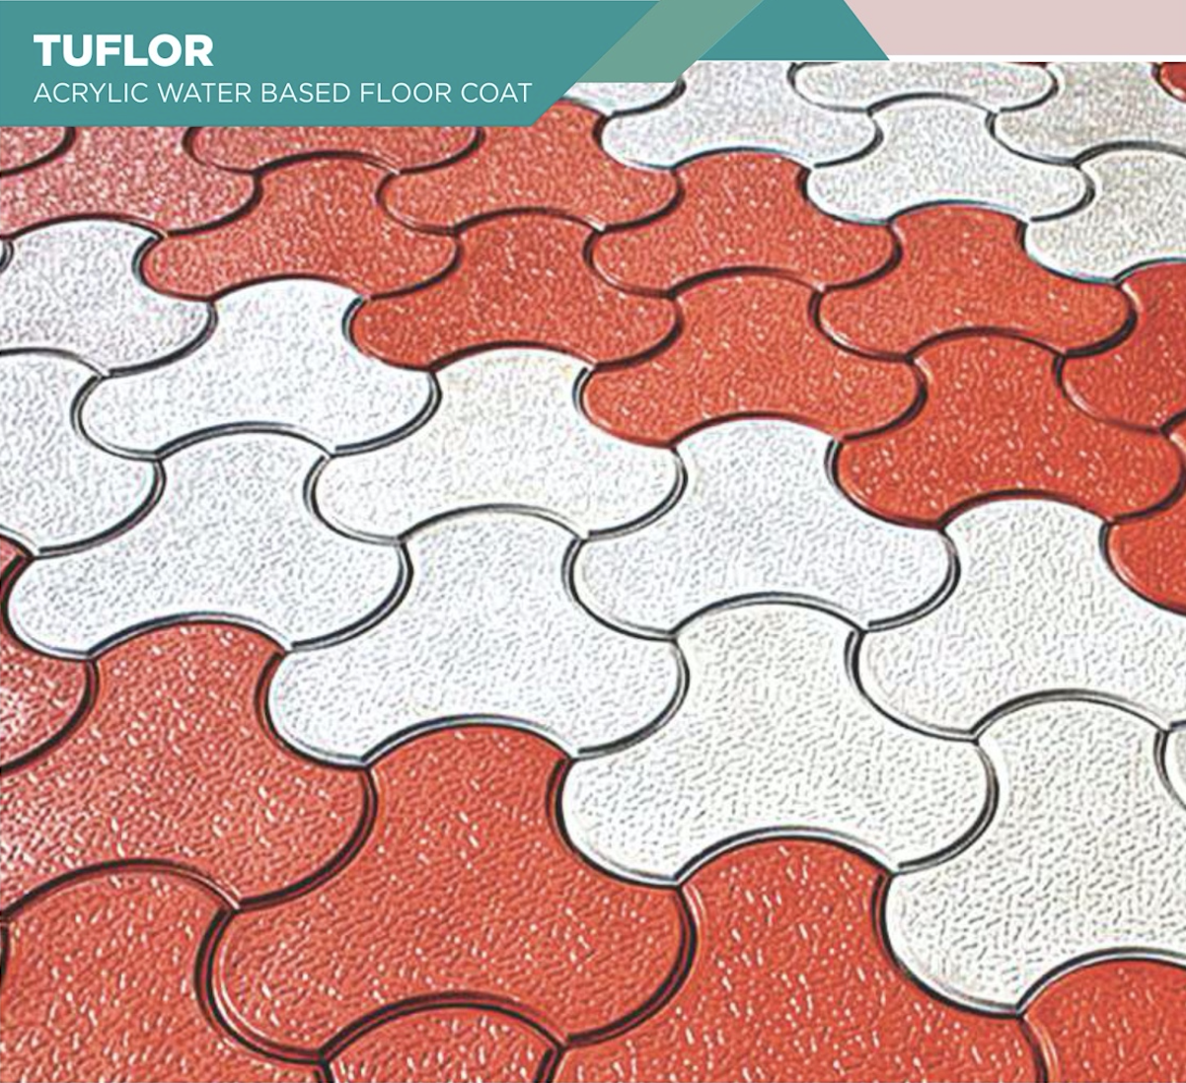
Our Product & Method of Application
TUFLOR:
Method of Application:
FILL ANY CRACKS ON THE FLOOR WITH APPROPRIATE CRACK FILLER
APPLY ONE COAT OF TUFLOR DILUTED BY 25% AS PRIMER
APPLY 2ND COAT OF TUFLOR WITH OUT DILUTION, DIRECLTLY.
APPLY 3RD COAT OF TUFLOR WITH OUT DILUTION FOR BETTER FILM BUILDUP OF PAINT.

Slide 7
Cost of TUFLOR per M2
PRODUCT TYPE | COST PER PAIL | COVERAGE /M2 OF PAIL | COST PER M2
TUFLOR 25% DILUTION | 3000.00 | 80 | 37.50
TUFLOR 2ND COAT | 3000.00 | 50 | 60.00
TUFLOR 3RD COAT (ONLY IF REQUIRED) | 3000.00 | 50 | 60.00
LABOUR COST |  |  | 20.00
TOTAL COST / M2 |  |  | 177.50
* Cost of product could change depending on cement plastering, paver blocks porous & total area of application

Slide 8
Next Steps
FOR TECHNICAL DATA SHEET OF TUFLOR PRODUCT, IT SHALL BE AVAILBLE WITH OUR SALES TEAM OR PLS EMAIL US ON OUR COMPANY ADDRESS.
FOR ONSITE PRODUCT SAMPLING PLS BOOK DATE AND TIME WITH OUR SALES TEAM.
FOR COLOR CONSULATION AND FOR CHECKING APPLICATED SITES PLS BOOK APPOINTMENT WITH OUR SALES TEAM.
PRODUCT AVAILABILTIY IS AT COMPANY HEAD OFFICE OR OUR RETAIL SHOWROOM IN SARIS NEAR BUNNA BOARD MULLEGE BUILDING GROUND FLOOR.
PLS JOIN OUR TELEGRAM CHANNEL @ABAYPAINT FOR MORE INFORMATION OF OUR PRODUCT RANGE AND NEW PAINT TECHNOLOGIES.

Slide 9

Contact Information
JELARAM ESDEE MANUFACTURING PLC (ABAY ESDEE PAINTS)
GOFA GABRIEL, OPPOISTE GAKY ENGINNERING, HONDA SHOWROOM, NEAR BETHEFAGE CHURCH
TEL: +251114672867 / +25111471240
SALES: +251922452563/65/66, +251912199093, +251910479781
REGIONAL SALES: +251933656874
EMAIL: INFO@ABAYPAINTS.COM
WEBSITE: WWW.ABAYPAINTS.COM

